Slide 1







PYEXPO25
Genius innovation leaves behind a legacy...
Team ID: T063
Team Name:Tech hackers(Registered in portal):
PS Number: PY070
PS Title: Smart City Complaint Management System
Domain:Web Development
Category:Software
PYEXPO 2025
IPS TECH COMMUNITY

Slide 2
Problem Statement:
The problem we are solving is the difficulty citizens face in filing complaints about issues in their city.
They must visit a respective office to submit a complaint.
Our solution is to create a web-based system that make citizens to submit complaints online
Making the process more accessible and efficient.
Target audience:
Citizens – People who want to complaint issues in their streets or area without going to respective offices
Municipal Authorities – Government departments responsible for handling and resolving complaints.
PYEXPO 2025
IPS TECH COMMUNITY

Slide 3
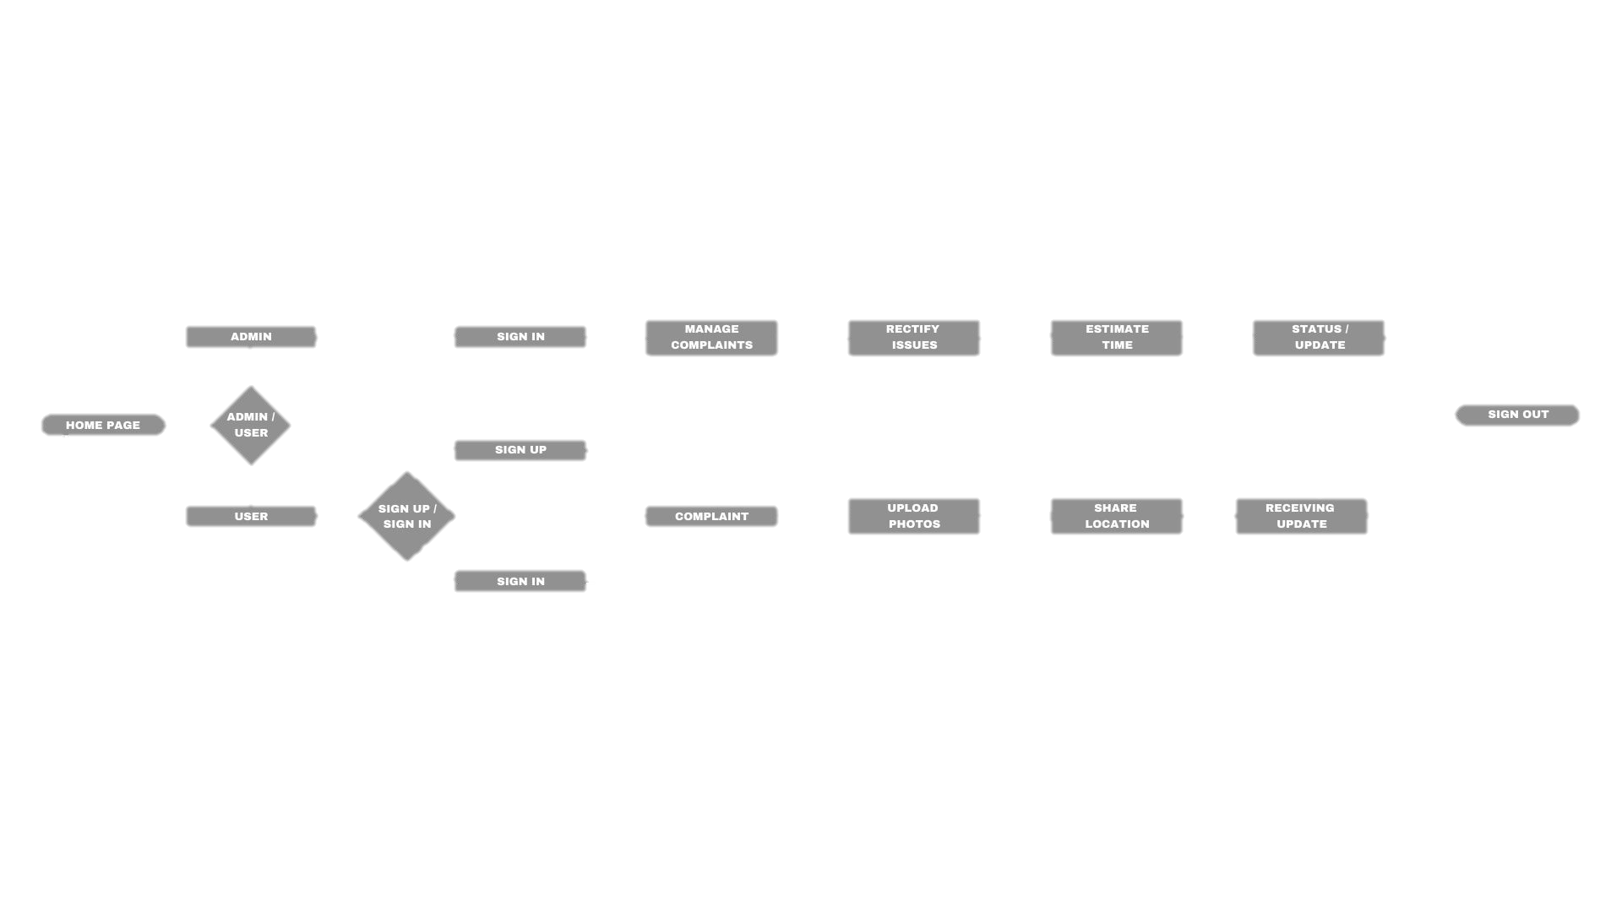
Proposed Solution:
Our web app provides a platform for citizens to submit complaints by adding their exact location.
The admin will analyze the complaint and forwards complaints to the respective departments.
Then respective department address the issue using the provided location and solve the issue.
Unique features:
Location-Based Complaint Tracking.
AI-Powered Chatbot.
Notifications & Alerts.
Major features:
User-Friendly Interface.
Django Framework for Efficiency.
Secure Database Management.
PYEXPO 2025
IPS TECH COMMUNITY

Slide 4
Technology Stack:
Front End:
HTML
CSS
Java script
Back End:
Python
Django
NLTK Module(For NLP chatbot)
Database:
postgres
PYEXPO 2025
IPS TECH COMMUNITY

Slide 5
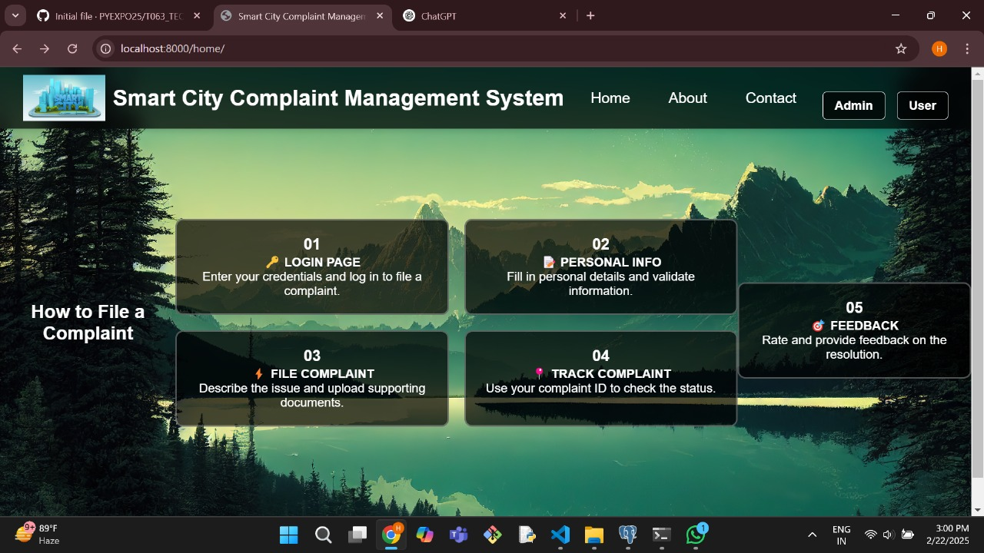
Demo:
PYEXPO 2025
IPS TECH COMMUNITY

Slide 6
Impact and Future Scope:
Convenience & Accessibility – Citizens can easily submit complaints online without visiting respective offices, saving time and effort.
AI-Powered Efficiency – The chatbot reduces manual sorting of complaints.
Location-Based Precision – Complaints linked to exact locations help authorities resolve problems.
Transparency – Users can receive message of the status of their complaints.
Potential features:
Image & Video Uploads – Users to attach photos or videos as proof of their complaints.
Automated Status Updates – Users receive real-time notifications via email or SMS about their complaint progress.
Research and References:
https://www.trichycorporation.gov.in/onlinegrievences
https://icts.smartccmc.com/public/Newgrievance.aspx
PYEXPO 2025
IPS TECH COMMUNITY

Slide 7
Team Member Details:
Name Roll No Dept
Heamanthraj S (TL) 24UIT121 IT
Aravinthkumar P 24UME104 MECH
Kumaravel T 24UEC150 ECE
Navinkumar M 24UAD207 AI & DS
Sabarinathan V 24UAD223 AI & DS
Sudharsan S 24UCS251 CSE
PYEXPO 2025
IPS TECH COMMUNITY

Slide 8
THANK YOU !

